Slide 1
Course Overview
15CSE402-Structure and Interpretation of computer Programs
By:
Dr. Rimjhim singh
Asst. ProfeSSOR (Sr. Gr.)
Department of CSE
Amrita Vishwa Vidyapeetham.

Slide 2
Objectives
Introduction to Functional Programming
Exposure to Procedural Abstraction
Apply and manipulate Abstract data
Understanding Modularity and Streams

Slide 3
Course Outcomes
Course Outcome | Description | Bloom’s Taxonomy Level
CO1 | Apply the elements of scheme programming to write functional programs | L3
CO2 | Formulate abstractions with (higher –order) procedures | L4
CO3 | Understand organizational principles and apply effectively the Scheme data structure, list, for program synthesis | L3
CO4 | Formulate and model abstractions with data | L4

Slide 4
SICP - Syllabus
15CSE402 Structure and Interpretation of Computer Programs 3-1-0-4
Unit 1
Introduction to LISP and Scheme - Building Abstractions with procedures: Elements of Programming procedures and the process they generate – Formulating Abstractions with higher-order procedures.
Unit 2
Building Abstractions with data: Introduction to data abstraction- Hierarchical data and the closure property – Symbolic data – Multiple representations for abstract data – Systems with generic operations.
Unit 3
Modularity, objects, and state: Assignment and local state – Environment model of evaluation – Modelling with mutable data – Concurrency – Streams.

Slide 5
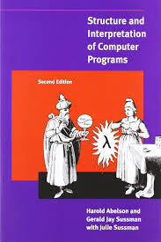
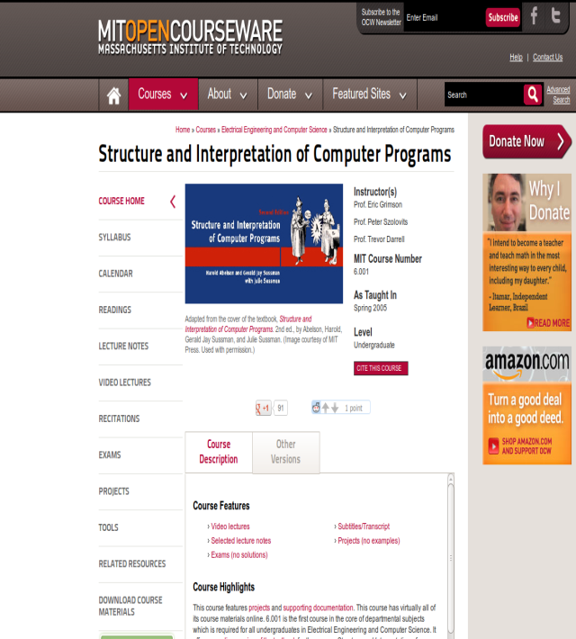
Text Book and References
Abelson H and Sussman G. J., “Structure and Interpretation of Computer Programs”, Second Edition, MIT Press, 2005.
MIT OPENCOURSEWARE

Slide 6
Evaluation Pattern
Component | Mode | Weightage
Internal - Midterm exam (30%) | Online (AUMS) and Microsoft Teams (Viva) | Online exam-10 % Viva – 20%
Internal - Continuous assessment (20 %) | Online (AUMS) and Microsoft Teams | Quizzes (3) – 7 % Tutorial (3) – 6% Case Study (2 evaluations) – 7%
External – End Semester (50%) | Online (AUMS) and Microsoft Teams (Viva) | Online exam- 20% Viva -30%

Slide 7
Teaching Materials / Mode of delivery
Live lectures - MS Teams
Demo - Dr.Racket IDE
Flipped Classroom - Recorded Videos

Slide 8
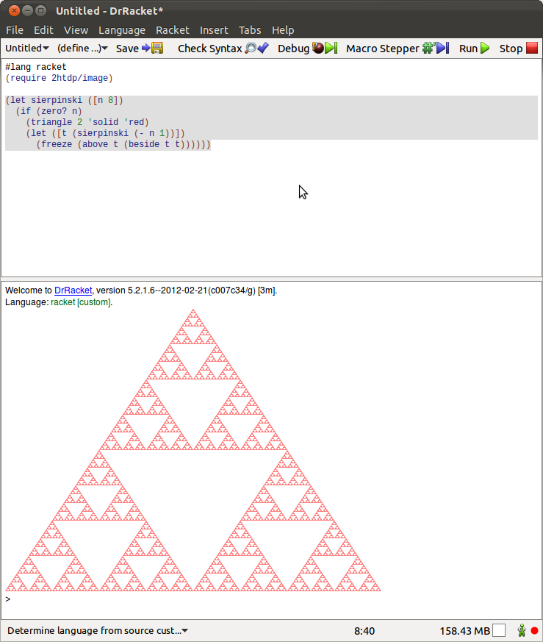

Tools Required
Racket – General purpose programming language(open source)
https://racket-lang.org/

Slide 9
SICP -Overview
SICP is to think about programming process.
It uses the idea of functions as data.
It addresses the techniques used to control complexity of large software systems.
If focuses on the idea of abstraction
It uses scheme language for understanding the techniques.

Slide 10
Functional Programming
Programs were constructed by applying functions.
It is a declarative type of paradigm which will not change the state of the program.
Functions can be passed as arguments, returned from other functions.
It is evolved from Lambda calculus.
Example: Lisp, Scheme, clojure.
Supported in language like C++, PHP, Python, Scala.

Slide 11
Introduction to Scheme
Functional programming language first appeared in 1975.
Scheme was developed at MIT AI lab by Guy L. Steele and Gerald Jay Sussman.
Scheme is a dialect of Lisp.
It uses Interpreter.
It is used in embedded system, compiler design, scripting , Google App inventor for Android.

